Slide 1
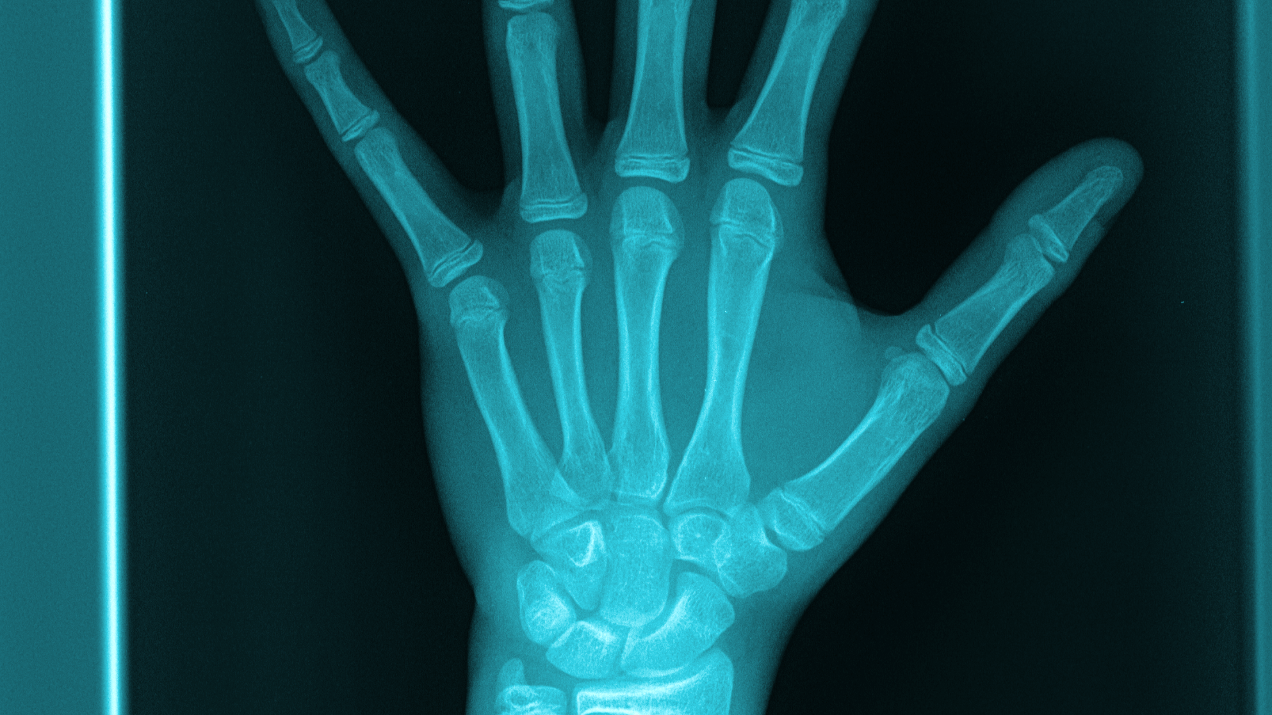
Bone Age Detection from X-ray
Group 01
Chirag Soni (1401CS13)
Vignesh Edithal (1401CS14)
Prashant (1401CS35)

Slide 2
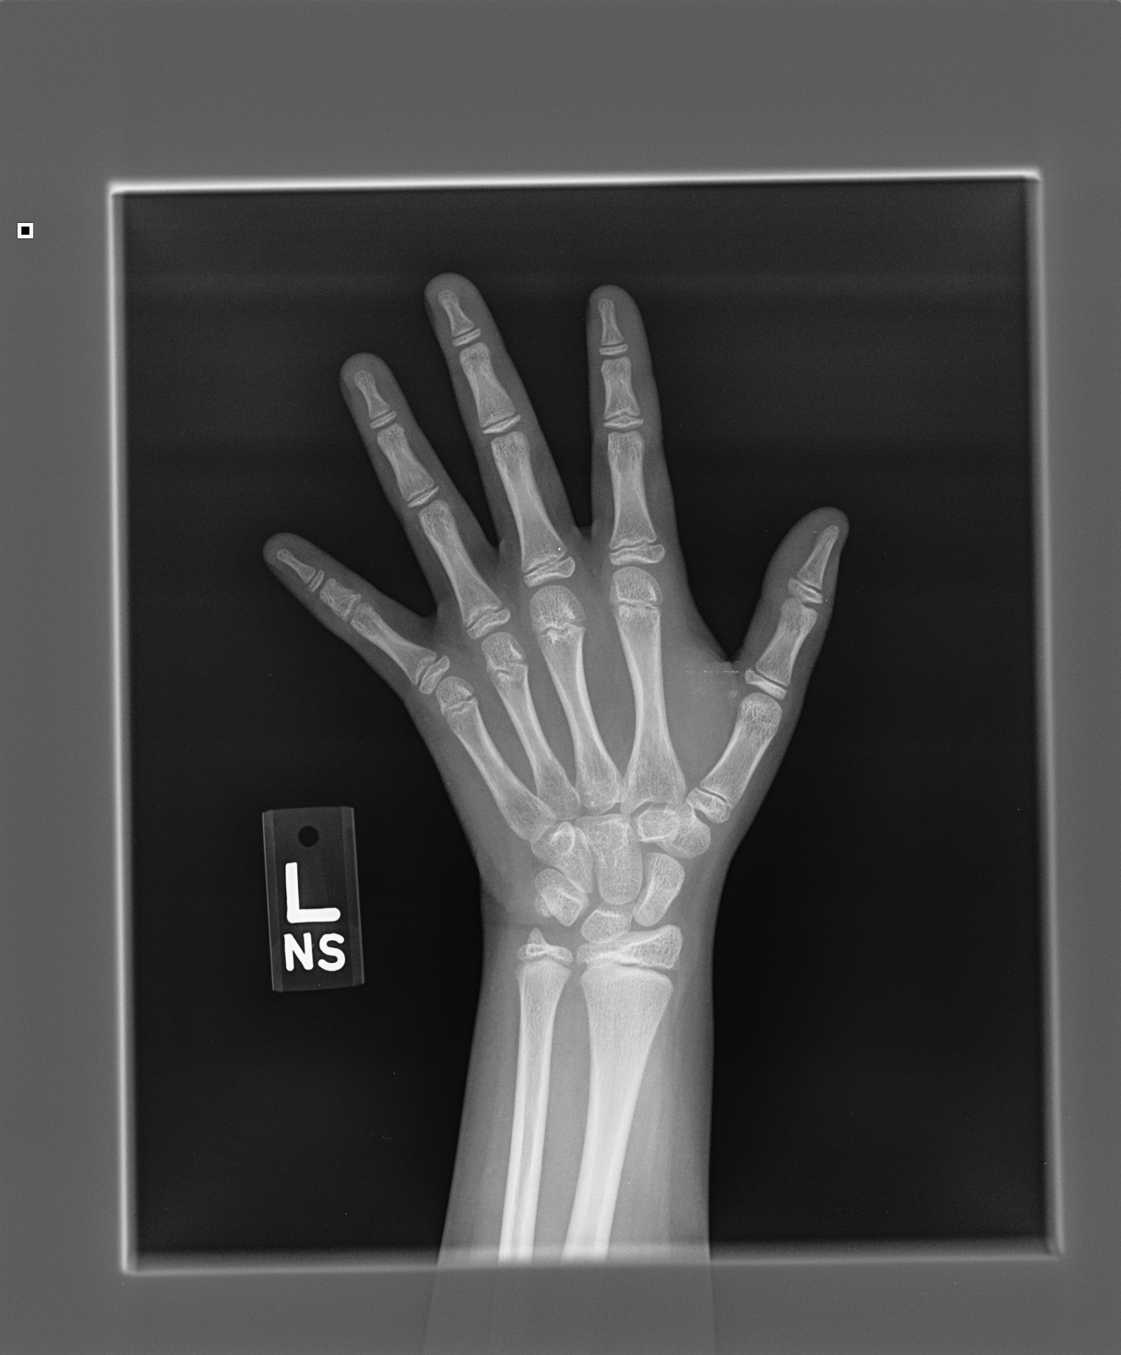
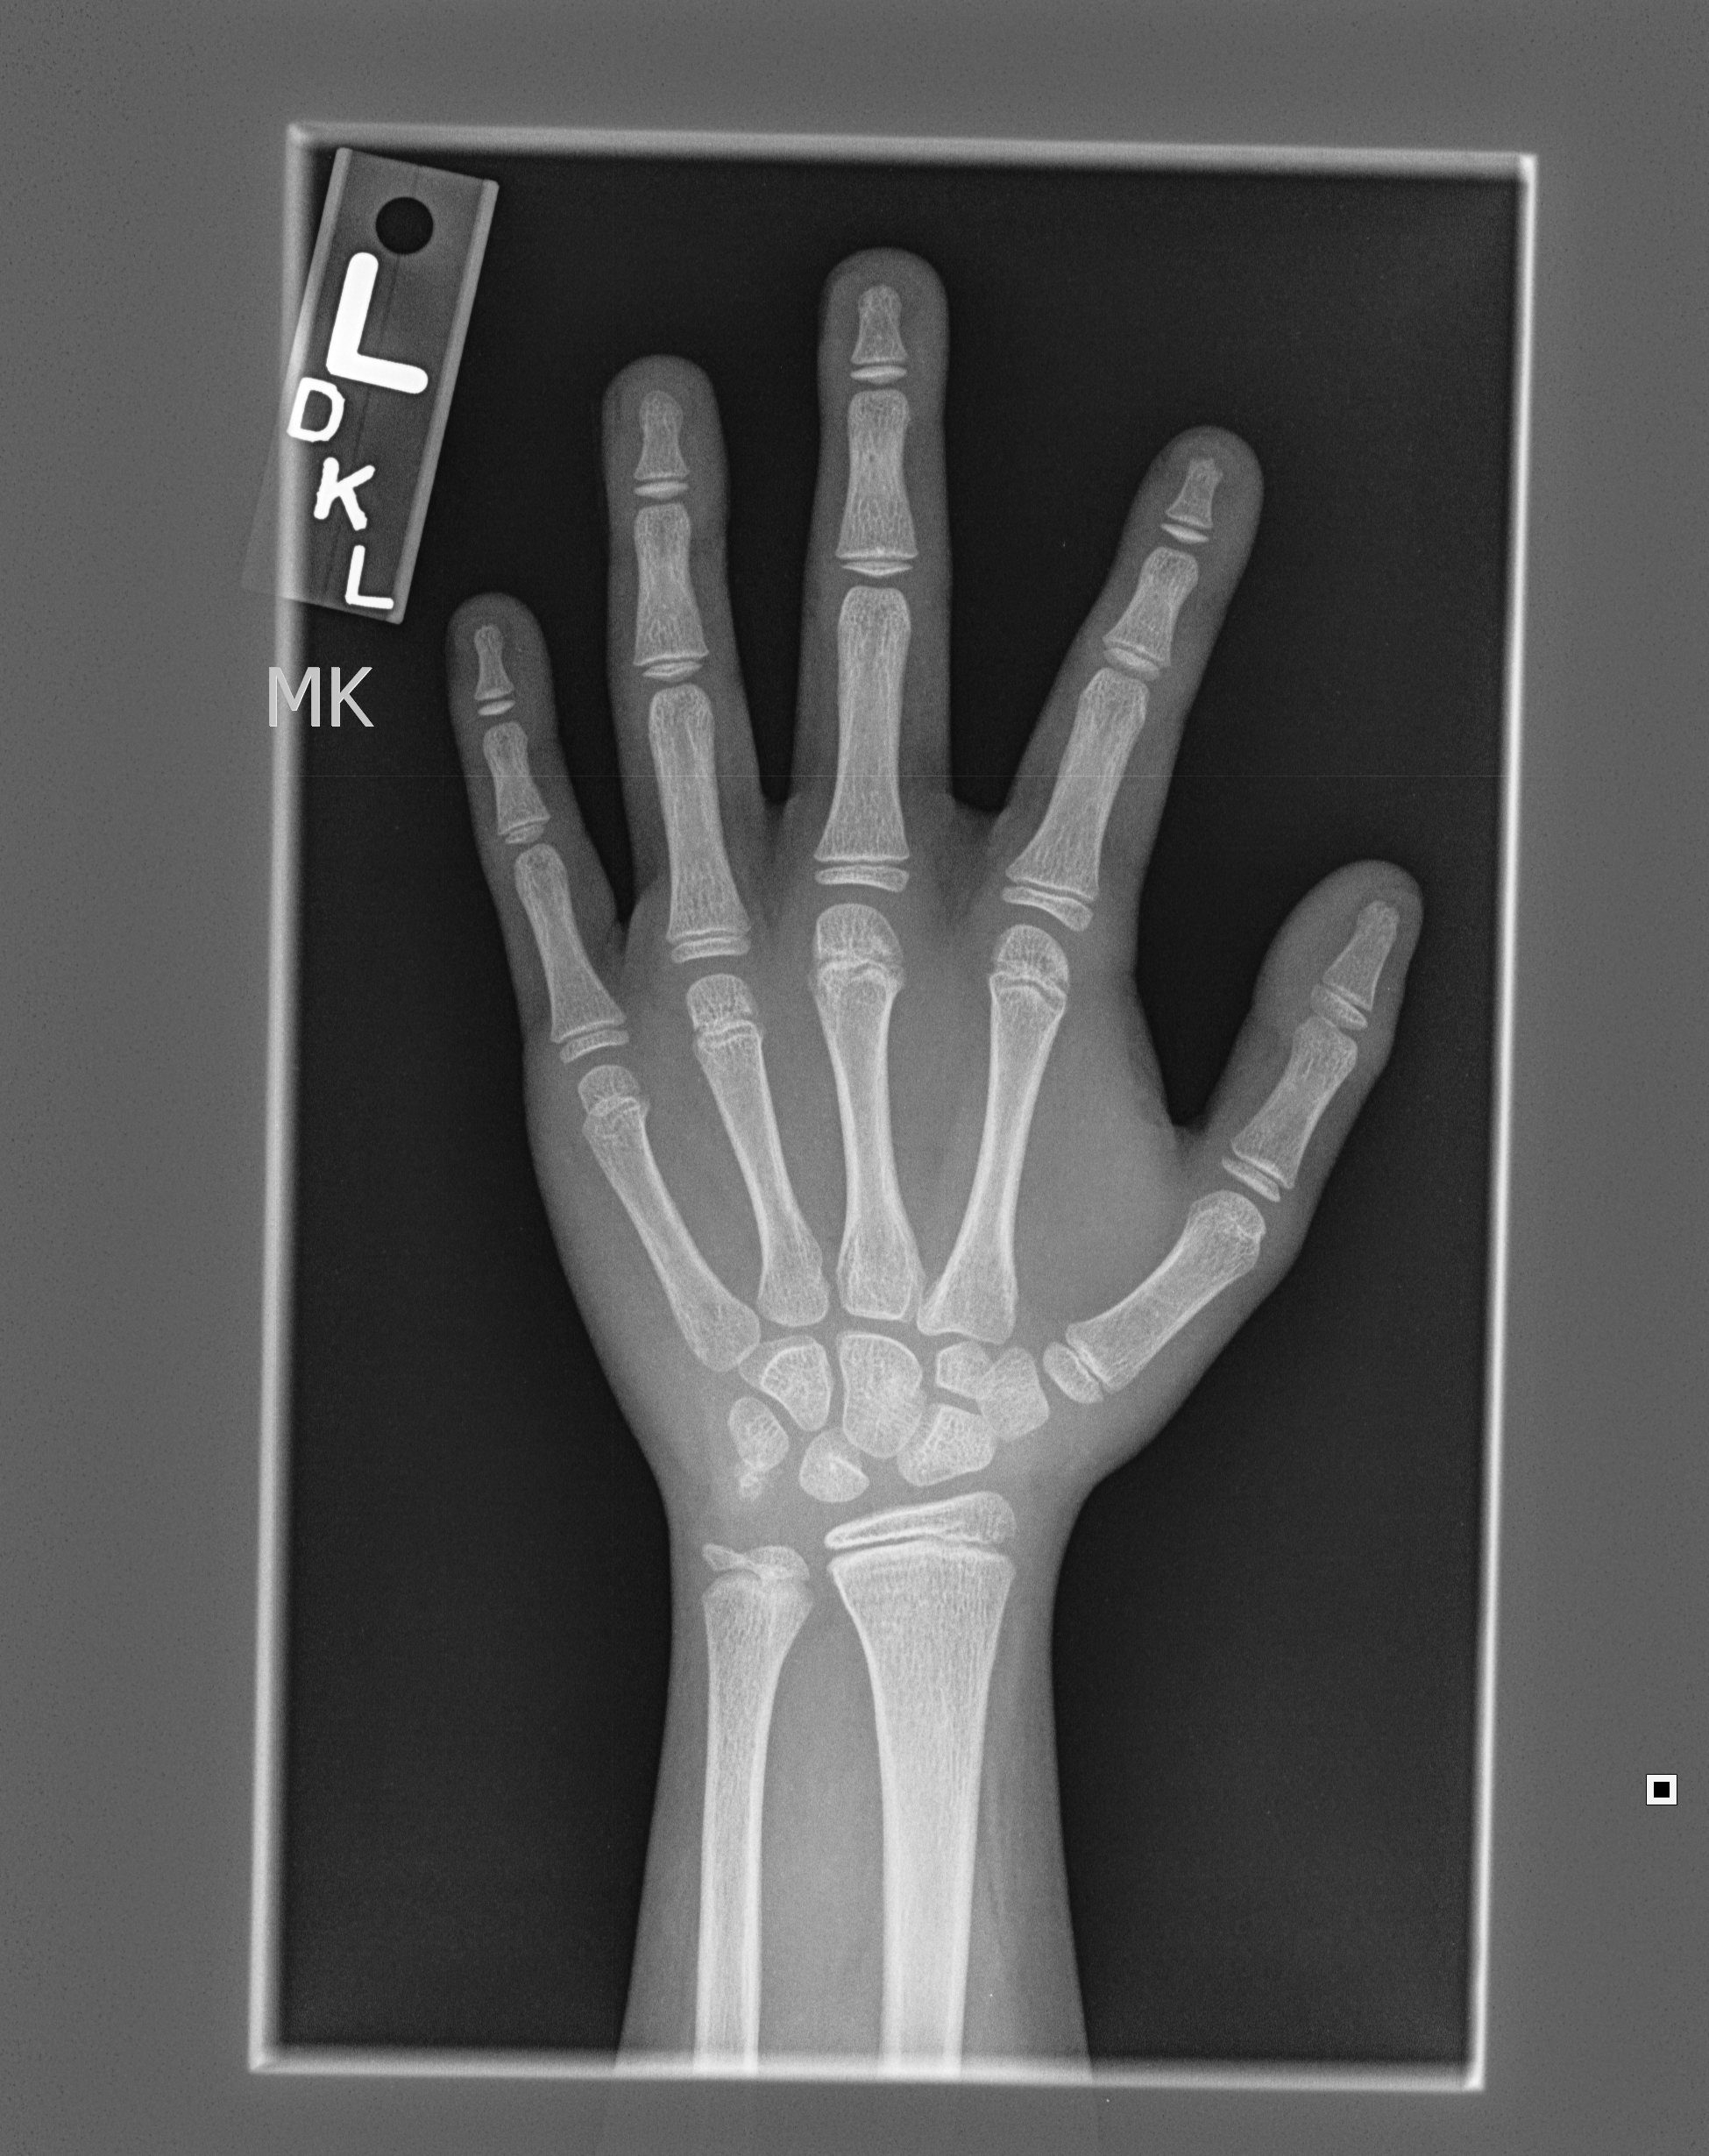
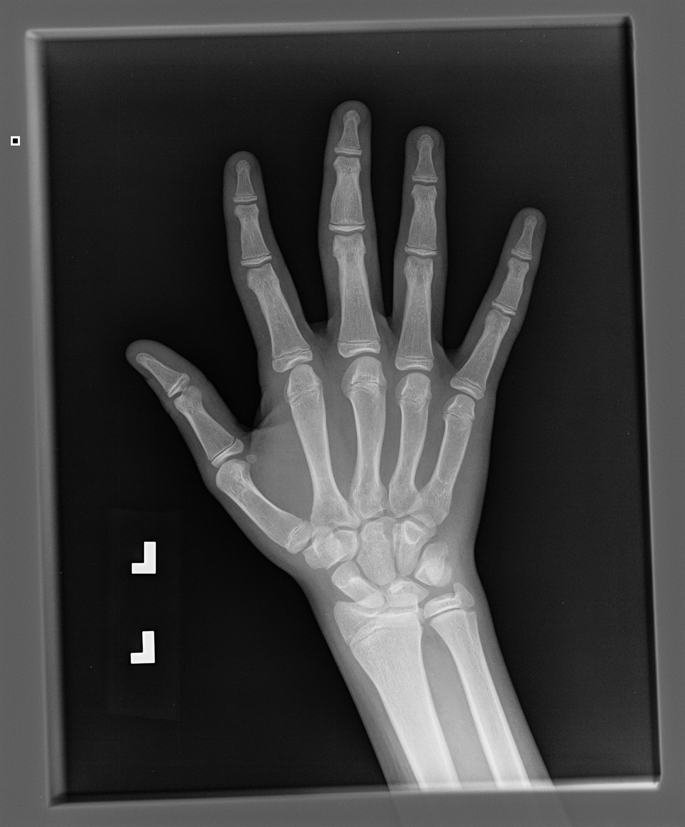
Introduction
Radiologists manually find skeletal age with help of atlas.
Compare skeletal age with actual age to ensure normal growth in children.
RSNA held competition to automate the process.

Slide 3
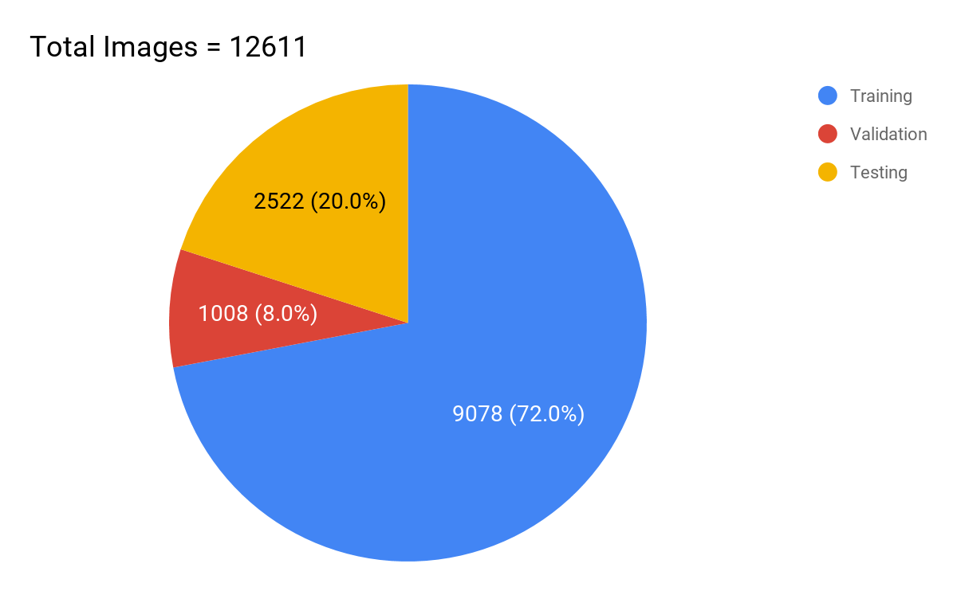
Dataset
1.png
id | boneage | male
1 | 180 | False
2 | 12 | True
... | ... | ...

Slide 4
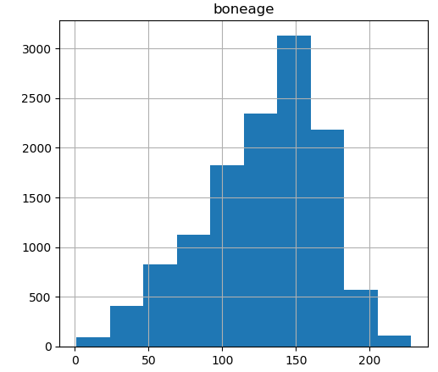
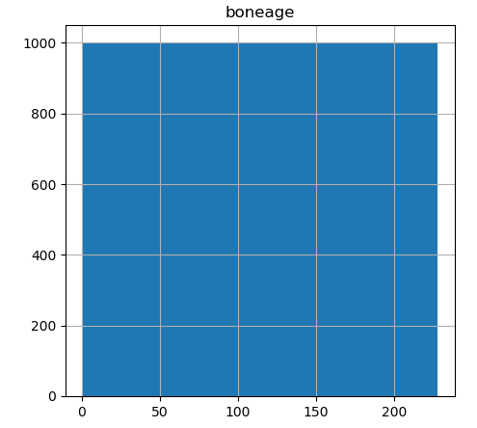
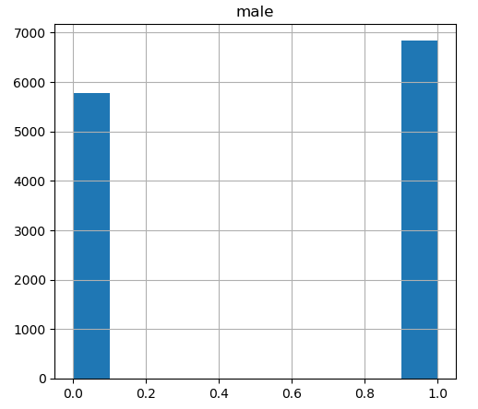
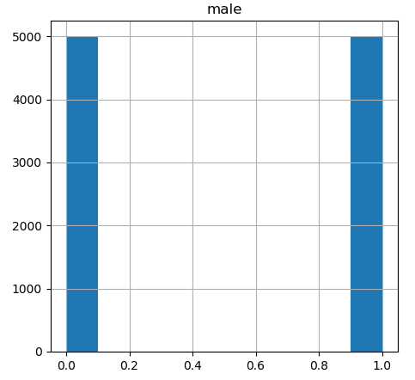
Balancing Dataset

Slide 5
Preprocessing
Age normalization (x - μ)/σ
Reduces effect of outlier data points
Reduce Image Resolution 2000x1500 ⟶ 224x224
Reduce redundant pixels while retaining information.
Rotation 5°
Horizontal/Vertical Translation 15%
Zoom 25%
Horizontal Flip
}
For better generalization

Slide 6
Architecture
Pixels
224x224x3
Gender
0 or 1

Slide 7
Architecture
Pixels
224x224x3
Inception V3
Gender
0 or 1

Slide 8
Architecture
Pixels
224x224x3
Inception V3
Gender
0 or 1
Dense
32

Slide 9
Architecture
Pixels
224x224x3
Inception V3
Dense
1024
Dense
1024
Gender
0 or 1
Dense
32

Slide 10
Architecture
Pixels
224x224x3
Inception V3
Dense
1024
Dense
1024
Age
months
Gender
0 or 1
Dense
32

Slide 11
Hyperparameters
Optimized over these parameters
Pooling : Average pooling / Max pooling
Dropout : 0.2 / 0.5
Activation function : ReLU / tanh
Gender : Use or not
Image Size : 224x224, 500x500
Pretrained models : Inception V3, VGG16, MobileNet

Slide 12
Training
Batchsize of 10
Trained over 50 epochs (early stoppage with patience 10)
Adam optimizer
Mean Square Error as loss function
Reduce Learning Rate on Plateau

Slide 13
Results
For the best model,
Test Mean Absolute Error = 8.615 months
train_loss = 0.0809
train_mae_months = 9.0737
valid_loss = 0.0709
val_mae_months = 8.1923
Code is uploaded on Github https://github.com/chiragiitp/Bone-Age-Detection-From-X-Ray

Slide 14
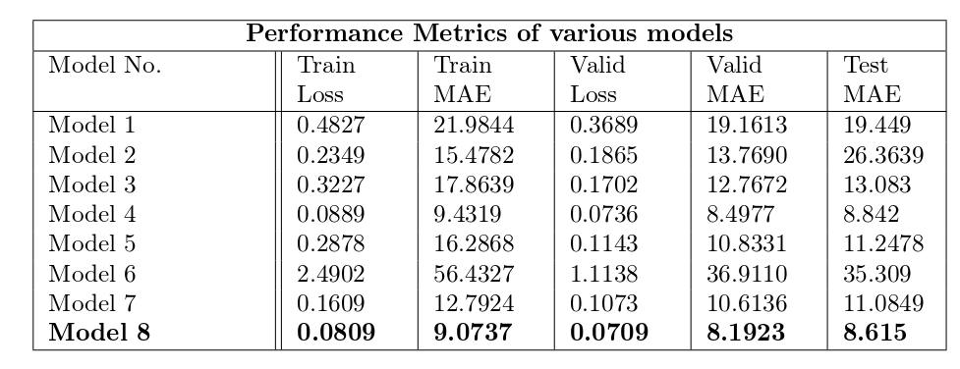
Results

Slide 16
Conclusion
Gender information is vital for the network.
Mean Average Deviation (MAD) between different human observers 0.61 years. MAD with the winning model is 0.36 years.
Deep CNN can surpass human level efficiency.
Should we stop training Radiologists now?

Slide 17
References
Kaggle 🔗
RSNA challenge🔗
Performance of a Deep-Learning Neural Network Model in Assessing Skeletal Maturity on Pediatric Hand Radiographs 🔗
Lee, H., Tajmir, S., Lee, J. et al. J Digit Imaging (2017) 30: 427. Fully Automated Deep Learning System for Bone Age Assessment 🔗

Slide 18
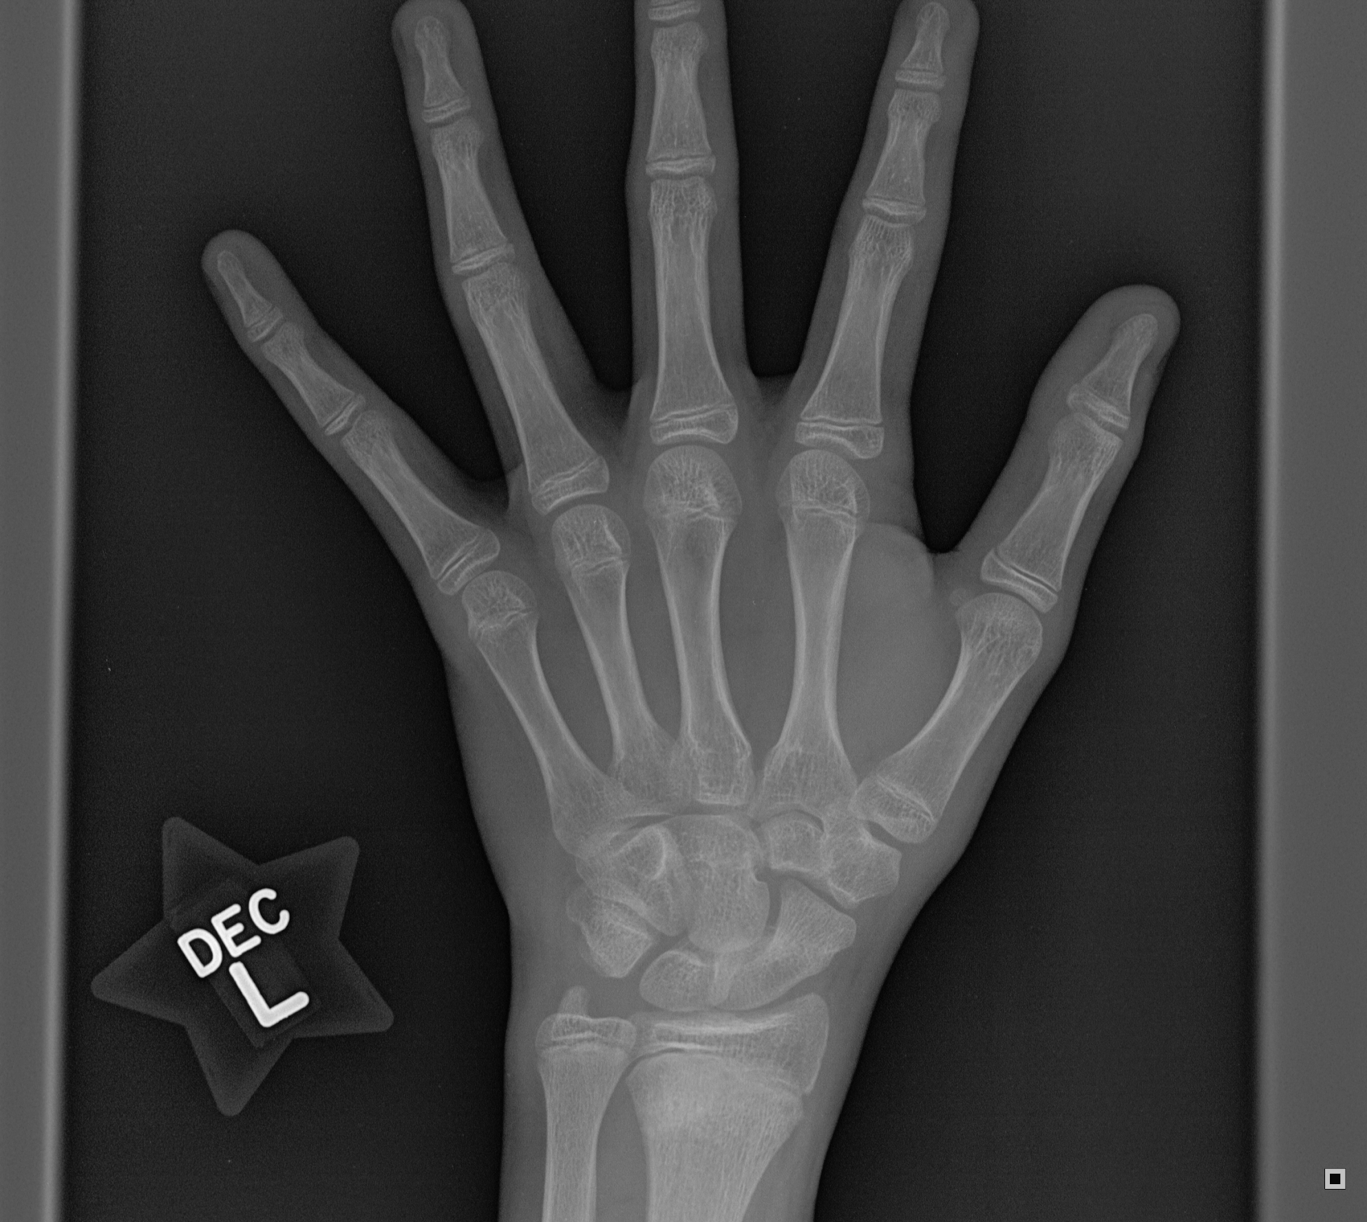
Thank you
Bye Bye

